Slide 1
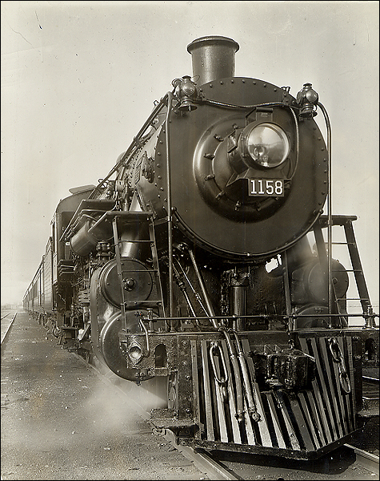
Chapter 23: The Age of Revolutions and Industrialization
Ms. Sheets
AP World History
University High School

Slide 2
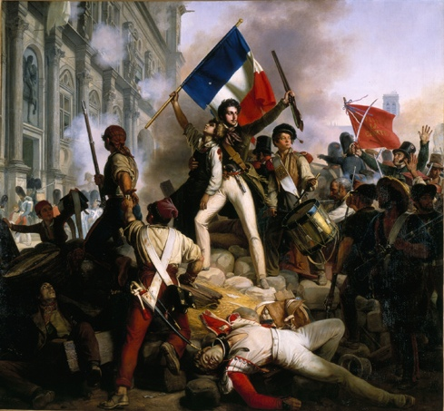
The Age of Revolution
Age of Revolution (1776-1848)
American Revolution (1776)
French Revolution (1789)
Revolutions of 1830
1848 Revolutions
Most Western nations had a parliamentary system by 1870s as revolutions rid countries of absolute monarchs
What contributes?
Intellectual challenges from the Enlightenment
Commercial growth and a new middle class of businessmen
Population pressure: threats to upper-class families and a growing proletariat

Slide 3
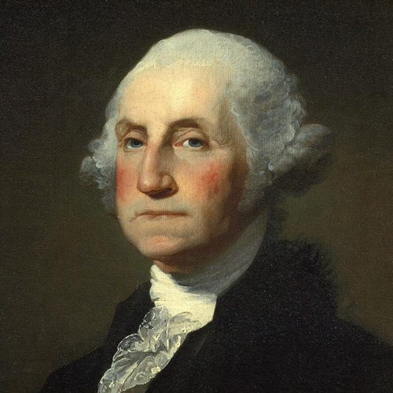
The American Revolution
Result of (among many things):
Enlightenment philosophies (social contract, rights of man)
American colonies developed unique identities separate from Britain
Colonists angered by new taxes and trade controls after Seven Years’ War ends in 1763 (Taxation without Representation)
Declaration of Independence of 1776 issued by the new American government
Life, liberty, and the pursuit of happiness
American Constitution in 1789
Separation of powers; checks and balances
Bill of Rights

Slide 4
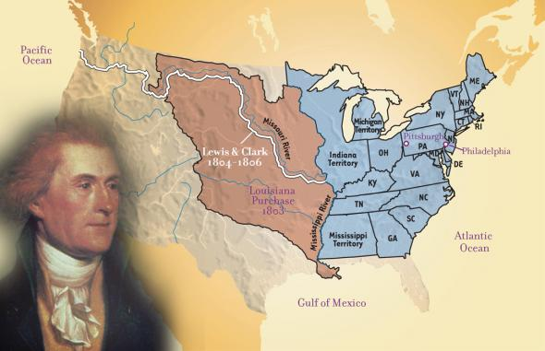
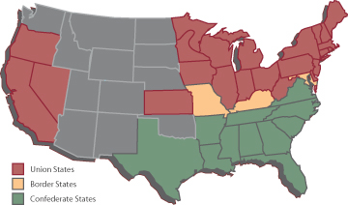
The growing U.S.
Manifest Destiny: American settlers are destined to expand to the Pacific
1803: Louisiana Purchase
1823: Monroe Doctrine
“Hands off” policy regarding European colonization in Americas
1861-1865: American Civil War
Industrial North vs. a slave-holding, plantation-growing South
Disputes over slaveholding
First modern war: industrially produced weapons and first instance of trench warfare
Accelerated industrialization

Slide 5
Quick Review Question
What factors cause the Age of Revolution to occur?
What were some of the factors that led to the American Revolution?
How did Manifest Destiny and the Monroe Doctrine affect the American identity?

Slide 6
French SOCIAL CLASSES IN 1789
1st Estate
CLERGY:
1% of population; NO taxes paid
2nd Estate
ROYALTY/ARISTOCRACY:
2% of population; NO taxes paid
3rd Estate
BOURGEOISIE; PEASANTS
97% of population; MUST pay taxes

Slide 7
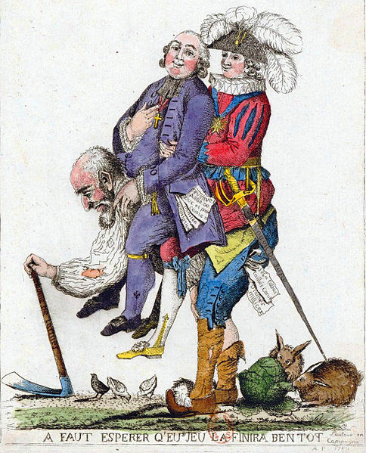
French Revolution of 1789
In 1789, Estates General had not been called by a French monarch in 175 years (not since Louis XIV)
The bourgeoisie (middle class) in the 3rd Estate became the driving force of the revolution.
97% of France belonged to Third Estate
Louis XVI was forced to call for an Estates-General meeting about tax reform; lost control
Bourgeoisie members insisted on one vote per representative rather than one vote per estate
June 14, 1789: Storming of Bastille
New National Assembly (Third Estate) issues Declaration of Rights of Man and Citizen (DOROMAC)
Liberty, right to property (not owned by state), security, and resistance to oppression
New constitution with new individual rights
France was now a parliamentary monarchy

Slide 8
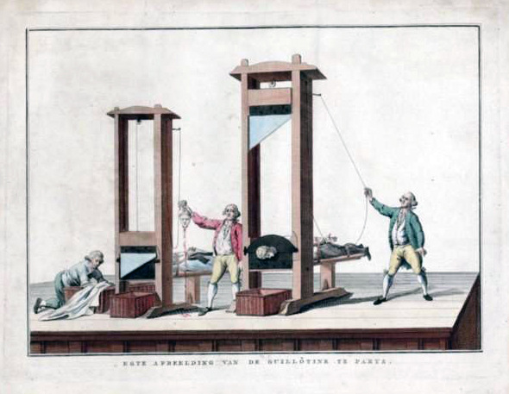
French Radicals and the reign of terror
Reign of Terror (1792-1795)
Led by Maximilien Robespierre and Jacobins
Use of the guillotine (40,000 died)
Regicide: executed Louis XVI and Marie Antoinette in 1792 for “conspiring against the nation”
“Cult of the Supreme Being”
Pushed revolutionary reforms in new constitution
Universal male suffrage
Military conscription: all male citizens

Slide 9
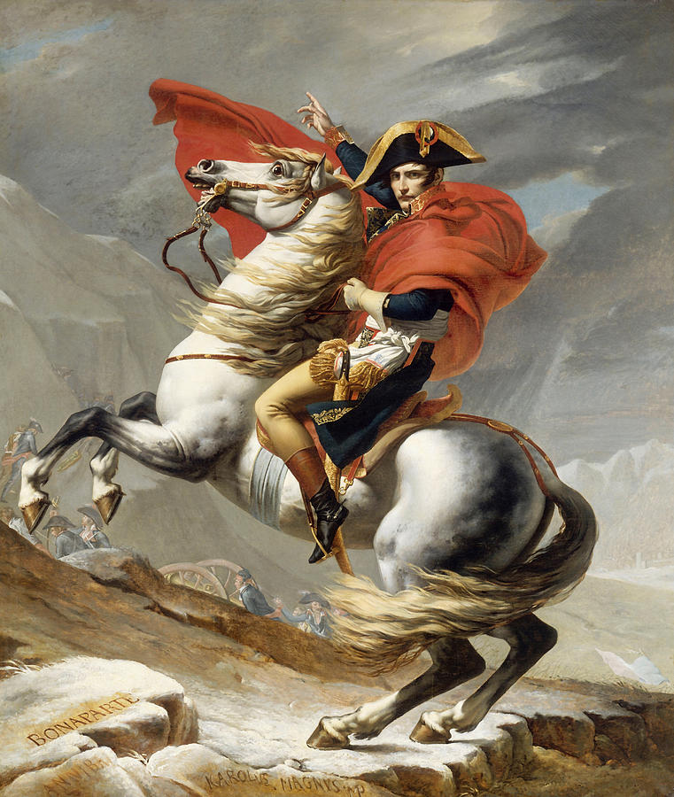
Napoleon Bonaparte
1799: Army general Napoleon Bonaparte rises to power
1804: Napoleon converted French republic to authoritarian empire by limiting power of assembly
Napoleonic Code (French law)
Censors press; religious freedom; universities
1812: controlled most of Western Europe
France began to fall after a failed 1812 invasion of Russia (result of harsh Russian winter)
1814: Defeated at Battle of Leipzig and exiled to Elba in Treaty of Fontainebleau
1815: Escaped, returned to power (Hundred Days), finally defeated at Battle of Waterloo
Duke of Wellington led British forces
Exiled to St. Helena (dies 1821)
Encouraged nationalism throughout Europe

Slide 10
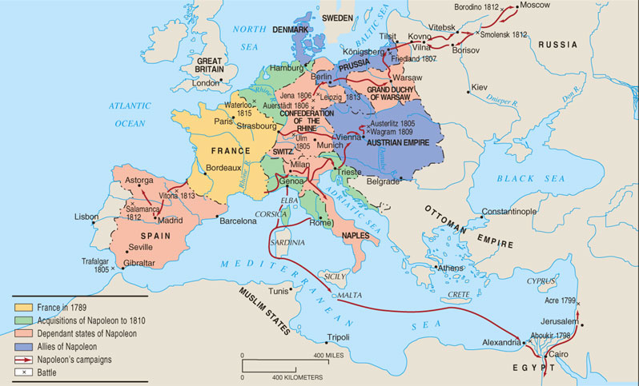
Napoleon’s Empire in 1812

Slide 11
Quick Review Question
What role does the Estates General play in the forming of the French Revolution?
What major event occurs during the Reign of Terror?
How does Napoleon transfer the French Republic to the French Empire?

Slide 12
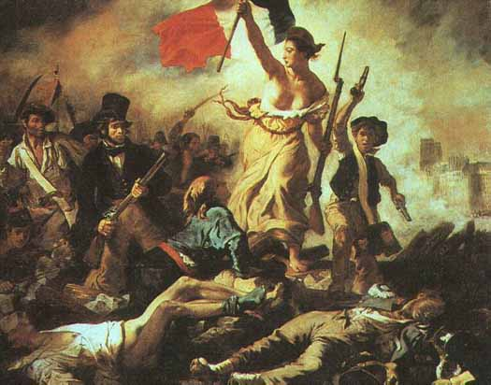
Aftermath of napoleon
1815: Congress of Vienna
Restored balance of power between European countries to prevent any European country from dominating continent again
New political ideologies emerge
Map of Europe redrawn; France gave up territory
More revolutions followed; tumultuous period
Greek Revolution of 1820
Revolutions of 1830
Belgian Revolution of 1830
July Revolution in France
1848 Revolutions (France, Germany, Poland, Italy, Austrian Empire)
Failures of revolutions: no permanent reform
Eugene Delacroix, Liberty Leading the People, 1830

Slide 13
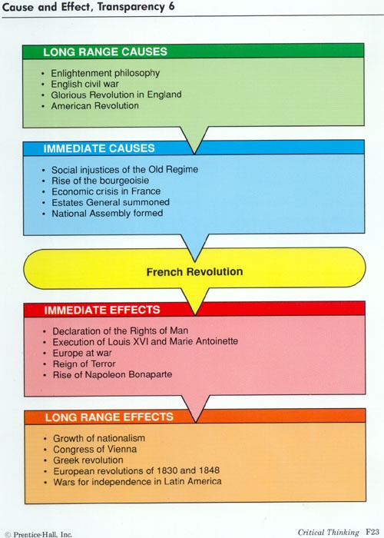
Causes and effects of the French revolution

Slide 14
New Political movements at the congress of Vienna
Growing political movements across Western Europe are seen at the Congress of Vienna
Conservatism: support monarchies, aristocracies, churches
Desire to maintain tradition
Conservative Western leaders worked to reduce the occurrence of political revolution after 1850
Liberalism: protect rights of propertied classes, limit state’s interference in individual life, obtain representation for propertied classes
Most bourgeoisie in the French Revolution were liberals
Radicalism: broad suffrage, social reforms, democracy

Slide 15
nationalism
Nationalism: intense belief in pride in one’s national culture which is associated with the territory in which they reside
Common factors leading to nationalism:
Common Culture
Shared Historical Experience
Common Language
Common Location
Will cause countries/empires to break up
Example: Austria-Hungary; British Empire
Will cause nations to be created
Example: Italy (1870) and Germany (1871)

Slide 16
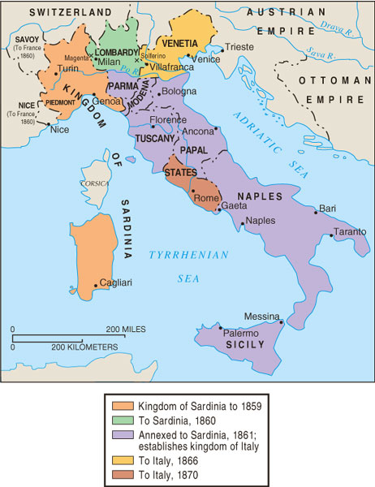
Unification of Italy 1859-1870
Italy divided into 9 states
Barriers to unification:
Illiteracy; the Pope; lack of consensus; lack of European support
Factors supporting unification:
Geography; pride in heritage; Italian culture
Count Camillo di Cavour leads nationalist movement
Parliamentary monarchy created under King Victor Emmanuel II
Problems:
Right to vote was limited to upper/middle class property holders
Disagreements over imperialism
Lacked industry and natural resources

Slide 17
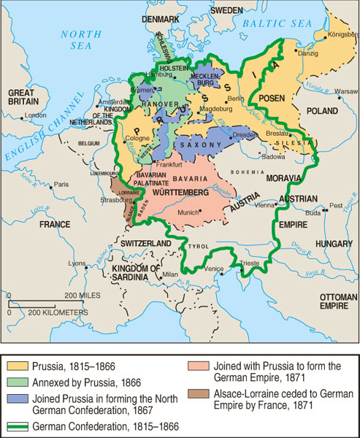
Unification of Germany 1815-1871
Holy Roman Empire dissolved in 1806 via Napoleon
After Congress of Vienna, German Confederation of 39 territories created → feelings of German nationalism
Largest German state: Prussia
Barriers to unification:
Europe fears a united Germany; Protestant/Catholic tensions (Thirty Years’ War); Prussia would be strongest state
Factors supporting unification:
Common culture; intellectual support (Goethe)
Otto van Bismarck, Prime Minister of Prussia and leader of German Confederation grew powerful
Franco-Prussian War (1870-1871) leads to French concession of Alsace and Lorraine (Treaty of Frankfurt)
1871: German states unified under Wilhelm I, King of Prussia and now German Emperor
First Reich: German Empire (1871-1918)
Second Reich: Weimar Republic (1919-1933)
Third Reich: Nazi Germany (1933-1945)

Slide 18
Quick Review Question
What was the Congress of Vienna? Its purpose?
Define nationalism. What two countries does nationalism promote in the 19th century?

Slide 19
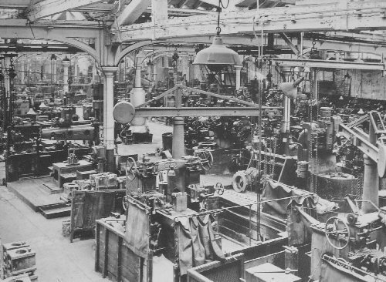
Industrial Revolution
Led to production of goods that occurred in the factory rather than the home
Factors of industrialization (CELL): Capital; Entrepreneurship; Land; Labor
Began in 18th c. English textile industry: England had money to invest, entrepreneurs, farm land, dispossessed farmers, and natural resources (coal, iron, timber, wool)
Agricultural changes: enclosure movement; rotating crops; fertilizers; breeding livestock.
After 1850: Second Industrial Revolution (use of steel and electricity)
Technological changes: steam engine (1770s); railroads; canals; steamships; telegraphs
Use of fossil fuels (coal, oil) greatly increased energy available to humans

Slide 20
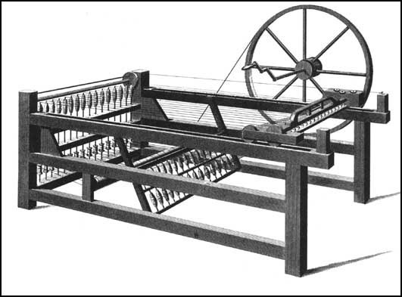
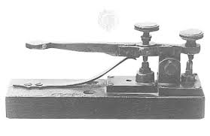
inventions in the Industrial Revolution
1712: Thomas Newcomen–steam engine
Powered trains, steamboats, factories
1764: James Hargreaves – spinning jenny
Spins multiple balls of yarn/thread at a time
1784: Edmund Cartwright - power loom
Weaves cloth from yarn
1794: Eli Whitney – cotton gin
Separates seeds from cotton
1844: Samuel Morse – telegraph
Allowed messages to be sent quickly
1846: Elias Howe – sewing machine
Clothes can be made in large factories
1876: Alexander Graham Bell – telephone
1879: Thomas Edison – light bulb
Spinning Jenny
Telegraph

Slide 21
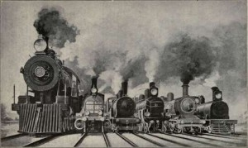
Industrial Revolution: Economic effects
Insurance; stock markets; gold standard
1860-1873: corporations in Europe doubled
Transnational companies
United Fruit Company; Hong Kong Banking Corporation
Supported by laissez-faire economics (Adam Smith) and economic liberalism (John Stuart Mill)
Railroads and canals were constructed; linked cities throughout Europe; increased diffusion of goods
1820s: France, Belgium, US, Germany industrialize
End of 19th c.: Russia, Egypt, Japan industrialize

Slide 22
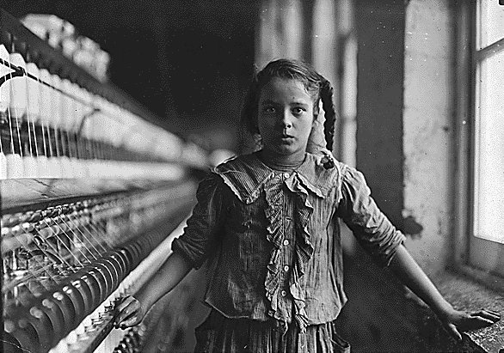
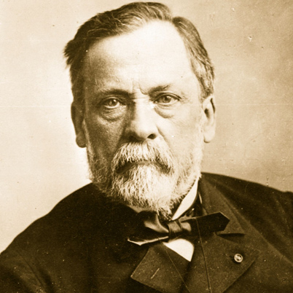
Industrial Revolution: Social effects
Factory workers
Dangerous conditions (Triangle Shirtwaist Fire)
Conform to factory schedules, long hours
Health concerns: noise; pollution; loss of limbs
Child labor
Wage discrepancies between genders
Social status: determined by wealth rather than social class
Industrial cities: rural → urban migration
Crowded; unsanitary; coal-produced smoke
Population increase in mid-18th c.
End of epidemic diseases
Improved diets (potatoes, etc.)
Infant mortality decreases, higher birth rate; lower death rate
1880s: Louis Pasteur’s germ theory of disease; hygienic practices in childbirth

Slide 23
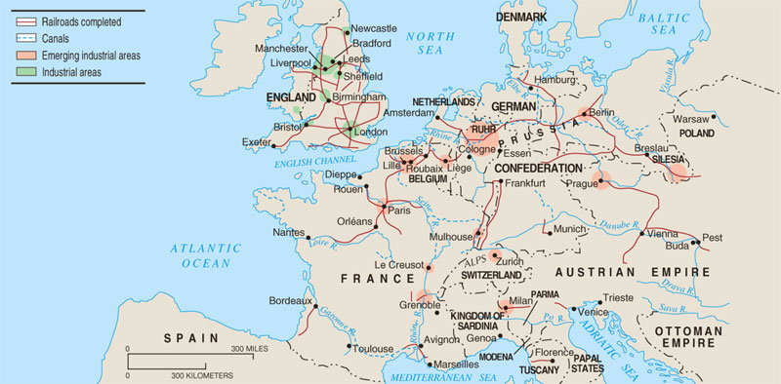
Industrialization in Europe, 1850

Slide 24
Quick Review Question
What are the factors of industrialization?
What were the economic effects of the Industrial Revolution?
What were the social effects of the Industrial Revolution?

Slide 25
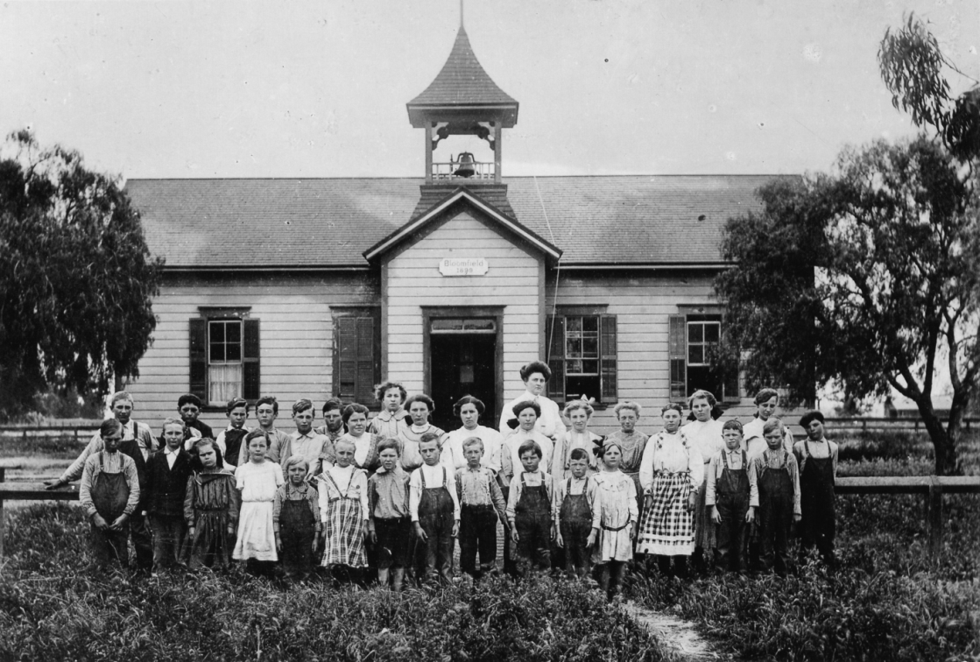
Government Functions
Civil service examinations in governments
Governments extended regulations into new areas
British PM Benjamin Disraeli granted vote to working men in 1867
Higher wages; shorter working hours
Welfare: accidents, illness, old age
The “Social Question” – what is the government’s responsibility in this area?
Triangle Shirtwaist Factory fire
Schooling expanded
Often mandatory until age 12
By 1900, 90-95% of Western Europeans and Americans were literate

Slide 26
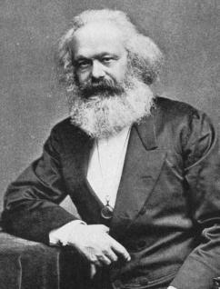
Communism/Socialism
Karl Marx’s The Communist Manifesto (1848)
Class struggle = group out of power (property-less proletariat) vs. group controlling the means of production (bourgeoisie)
If new constitutions granted individuals the right to private property, then the wealthy will own much more than the poor
Grievances of proletariat will lead to revolution; full freedom will be achieved
Class struggle would end because class systems would be eliminated
Private property should not be protected; communal resources
Rise of socialism in Germany, then extend to Austria, France by 1880s
Criticism: success regarding political/societal harmony could be achieved by peaceful means; support parliamentary monarchies to achieve goals

Slide 27
1st Estate
(Church)
Industrial Revolution
Bourgeoisie
(Controllers of the means of production)
2nd Estate
(royalty and aristocracy)
Proletariat
(Property-less working class)
3rd Estate
(bourgeoisie and peasants)
1) Early Modern
European Classes
2) Post-Industrial Classes
Socialist Revolution
Classless Society
-NO private property
-Equity of resources and production
3) Post-Socialist Revolution

Slide 28
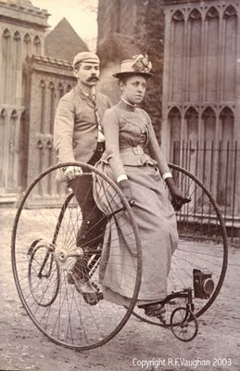
Cultural Changes
White-collar labor force grows in the working class
Secretaries, clerks, salespeople
Sometimes fulfilled by unmarried women
Widespread advertising promoted products in new consumer culture
Product crazes
Higher wages led to increased spending
Mass leisure culture shows growing secularism
Bicycle fad of the 1880’s
Vacations
Theatre, comedy routines, entertainment
Team sports (soccer, football, baseball)
1896: Olympic games

Slide 29
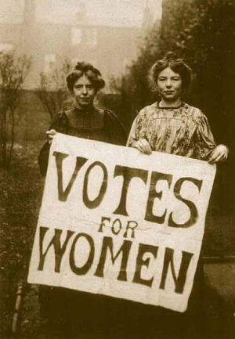
Feminist movement
Feminist movements by 1900s
Also called “first-wave feminism”
Emerges out of liberal and radical politics
Primarily focused on women’s suffrage (right to vote)
Seneca Falls Convention, 1848: outlines movement’s ideology and political strategies
Mary Wollstonecraft’s A Vindication of the Rights of Women & Olympe de Gouge’s Declaration of the Rights of Women were influential texts
Suffrage in 1918 for USA, Germany, Britain, Austria
Most participants were middle class women
Often joined with temperance and abolitionist movements; way to justify needing the vote
Challenged “cult of domesticity” and patriarchy

Slide 30
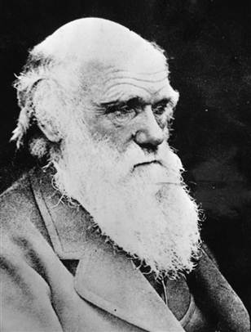
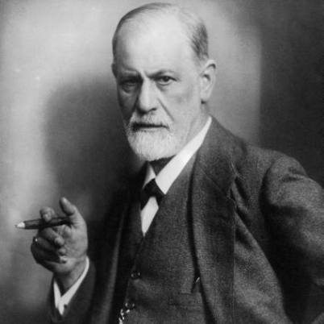
Scientific advances
Built on traditions of rationalism and empiricism: Renaissance, Scientific Rev
Now have more advanced technology
Charles Darwin’s On the Origin of Species (1859)
Theory of natural selection: all current living species evolved and adapted in order to survive
Controversy with Judeo-Christian Bible
Albert Einstein’s theory of relativity
Time as a factor in physical measurement
Sigmund Freud: human subconscious and psychoanalysis

Slide 31
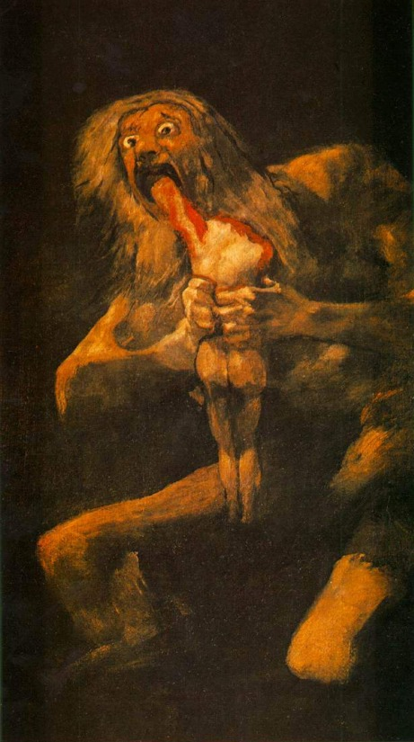
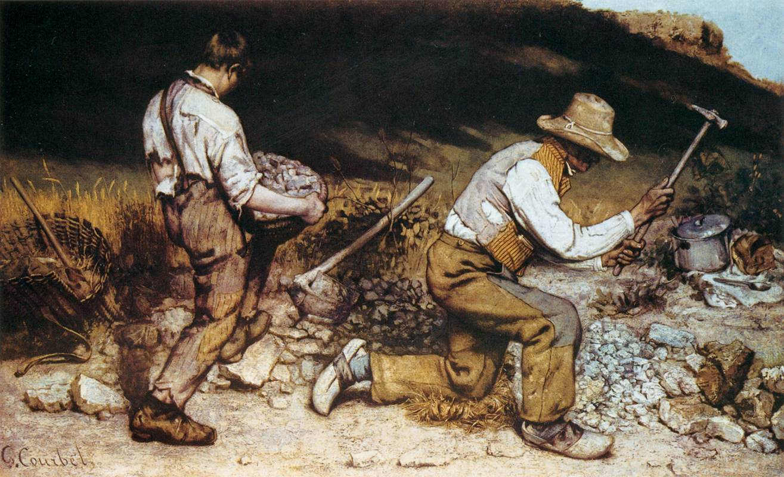
19th century art and literature
Diverges from the order and rationality that science presented
Romanticism: emotion is key to human experience, not reason and generalization.
Art: intense passion, madness, interest in literature
Literature: move readers to tears, not to debate or educate (Frankenstein; Jane Austen; Hunchback of Notre Dame)
Realism: focus on the plight of the working class; accurate depictions of ordinary world
Art: show the grittiness of laborers
Literature: Charles Dickens
Goya’s Saturn Devouring His Children
Courbet’s Stone Breakers

Slide 32
Quick Review Question
What are the factors of industrialization?
Describe first-wave feminism.
What popular cultural changes occurred in this time period?

Slide 33
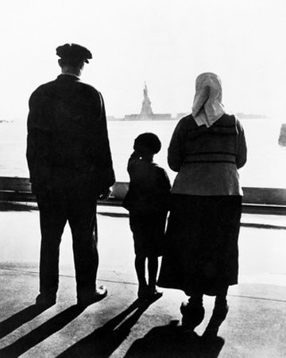
New western societies
Western power and influence rose
Industrial Revolution created the need for new markets and the need for new raw materials.
New European colonies
Industrialization of the West’s military
Repeating rifle and machine gun
Enables spread of Western empires
Steamships enable massive European emigration
Many societies became immigrant majorities
Immigrants: Germans, Italians, Greeks, Hungarians, Jews, Poles, Irish (Potato Blight / Great Famine); Chinese
All groups face various levels of discrimination (Chinese Exclusion Act; White Australia Policy)
All groups brought their cultures with them and created ethnic enclaves

Slide 34
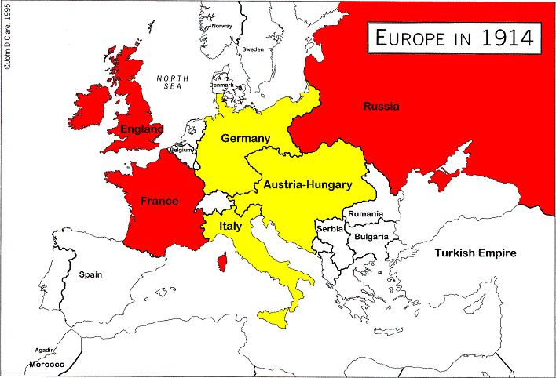
M.A.I.N. Causes of WWI
Militarism: New industrial weapons; artillery levels and naval forces grew steadily
Alliances: Emergence of new Germany disrupts power balance in Europe → complex alliance system created
By 1907, most European nations were in an alliance
Triple Alliance: Germany, Austria-Hungary, Italy
Triple Entente: Britain, Russia, France
Imperialism: Imperialist expansion fed the sense of rivalry between nation-states
Nationalism: Balkan independence from Ottomans; new Germany and Italy

Slide 35
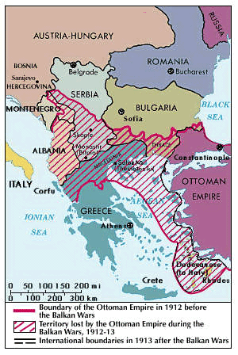
Start of World War I
1912-1913: Balkan Wars for Independence
Small Balkan nations created after winning independence from the Ottoman Empire
Serbia did not gain as much territory as it thought it should have been granted
Hostilities in Balkans persist as new and unstable countries are plagued by ethnic nationality disputes
1914: Archduke Franz Ferdinand of Austria-Hungary was assassinated by a Serbian nationalist
Russia mobilized its troops against Austria, as alliances engage
World War I begins on August 1st, 1914

Slide 36
Quick Review Question
What were the main causes of WWI?
Who is in the Triple Alliance? The Triple Entente?

