Slide 1
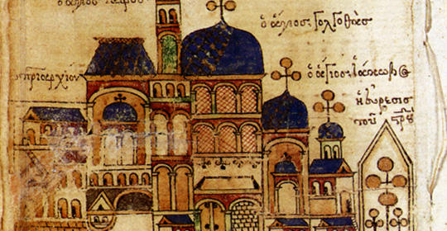
Chapter 9: The Byzantine Empire and Orthodox Europe
Ms. Sheets
AP World History

Slide 2
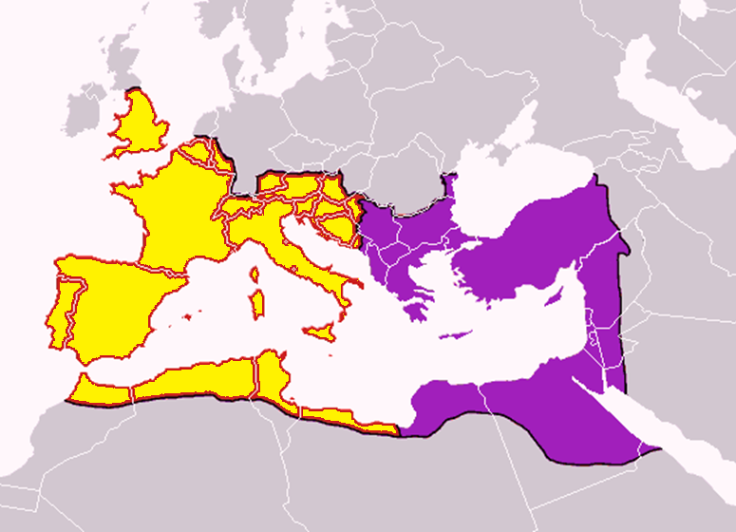
Post-Roman Empire:
Political and Religious Divisions
Two Christian civilizations develop out of the splitting of Roman Empire.
East (will practice Greek Orthodoxy)
Byzantine Empire
West (will practice Roman Catholicism)
Feudal kingdoms
Civilizations expand and spread north largely because of: 1) religious missionaries and 2) inability to convert one another.
Religions are culturally, and later religiously, separate

Slide 3
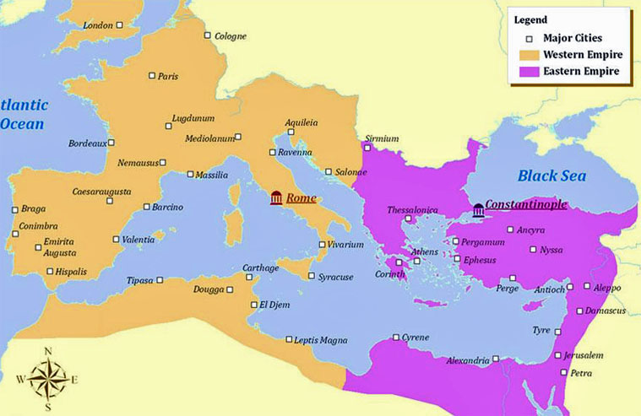

Slide 4
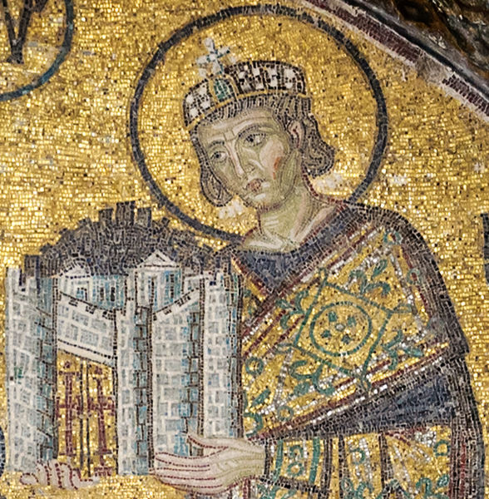
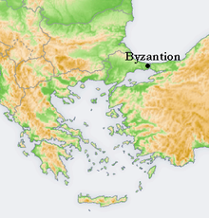
Byzantine Empire
324 CE: Emperor Constantine of Roman Empire built Byzantium/ Constantinople
476 CE: Western half of empire collapses; division between West/East
In East, Constantinople is the capital (cosmopolitan, opulent, wealthy)
Involved in Mediterranean and Central Asian commerce
Greek/Eastern Orthodox Christianity
Retain strength despite rapid growth of Islam
Spread culture and politics to parts of world that had not been controlled by any major civilization
Balkans, western Russia

Slide 5
Quick Review Question
After the Roman Empire collapses in the West, what becomes of each “side” (East vs. West)?

Slide 6
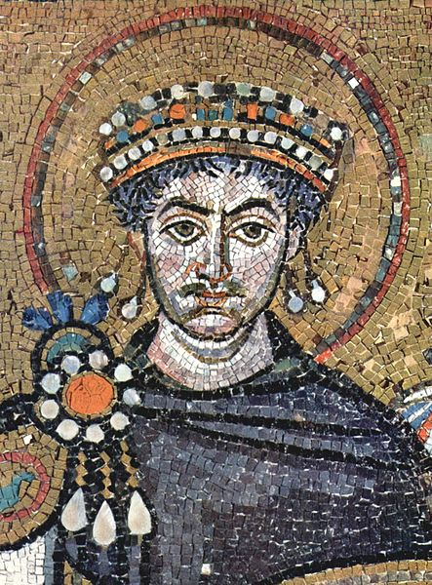
Justinian (Reigns 527-565)
Most significant Byzantine ruler
1) Military gains and huge expansion to rebuild original Roman Empire
Gains in North Africa and Italy
2) Systemizes Roman legal code
Influences future law codes in Europe
Reduces legal confusion; united and organized the new empire
3) Projects to renovate Constantinople
Hagia Sophia – engineering and architectural achievements (dome)
4) Makes Greek language official

Slide 7
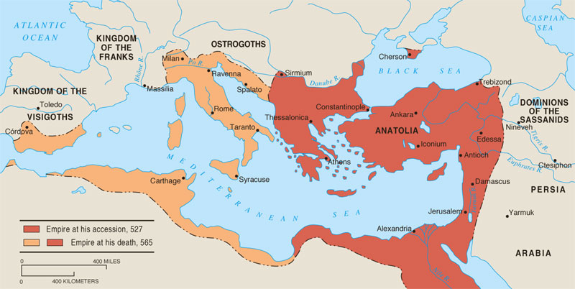
Byzantine Height under Justinian

Slide 8
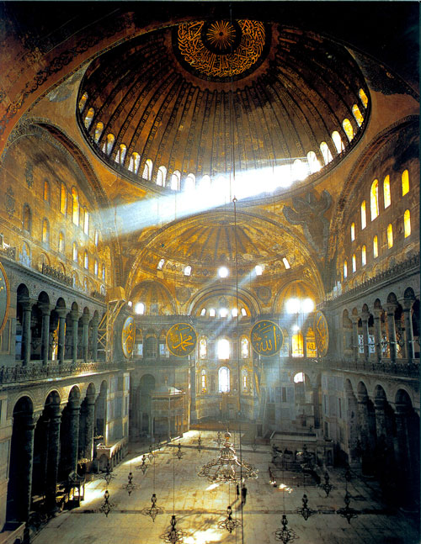
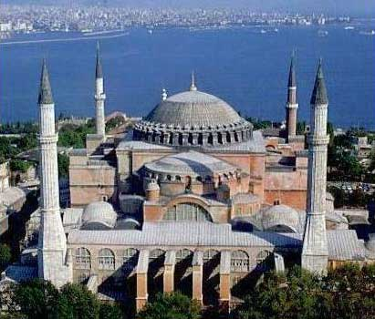
Hagia Sophia
Light as symbol of God; dome
Minarets: towers to call people to prayer
Mosaics: decadent, reflective

Slide 9
Quick Review Question
What were Justinian’s accomplishments?

Slide 10
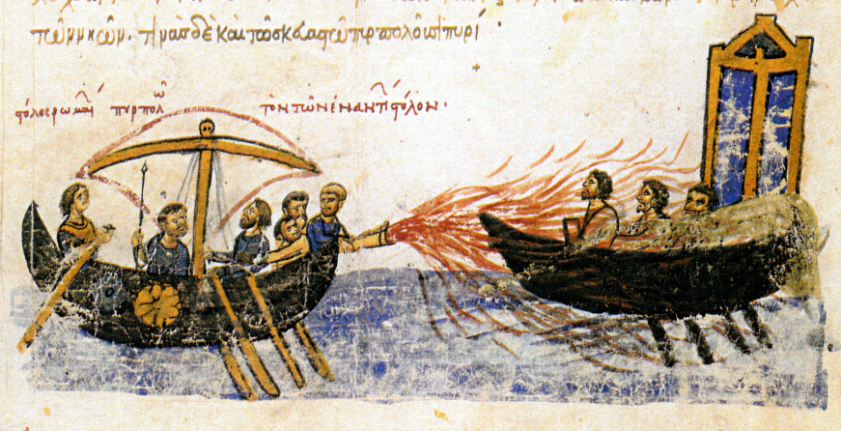
Muslim Pressure and Byzantine Defenses
Byzantine rulers’ primary concern was defense against Muslim invaders
Muslim siege of Constantinople (711 CE): Byzantines able to hold off Muslims, but with losses in Mediterranean
Muslim naval fleet is skilled vs “Greek fire”
Byzantine’s size/strength reduced because of Muslims
Economic burdens and loss of territory
Increase in taxes
Weak emperors; aristocratic estates grow larger

Slide 11
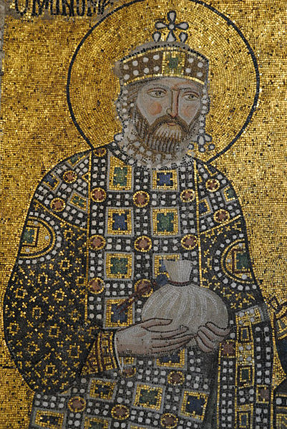
Byzantine Politics
Rulers saw themselves as Roman emperors and as ordained by God; government was seen as continuation of Roman Empire
Emperors were head of government and church (caesaropapism)
Complex bureaucracy (open to all classes but aristocrats dominate)
Bureaucracy helped to organize empire politically, socially, and economically.
Provincial governors appointed
Spy system created loyalty and ensured safety
Troops recruited locally and given land for their services
Hereditary military leaders gained too much power

Slide 12
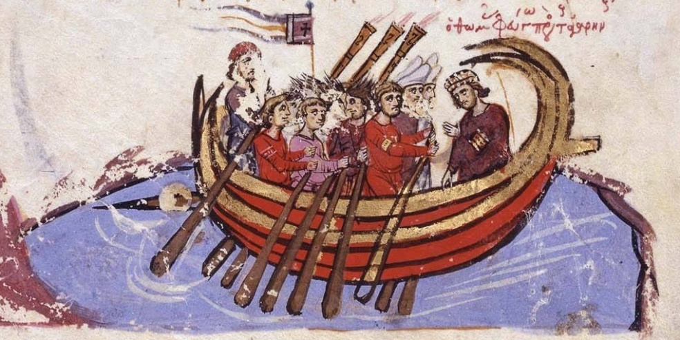
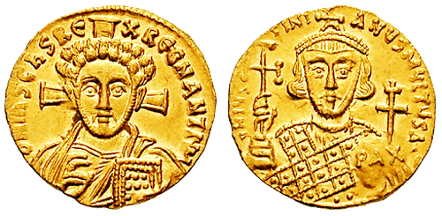
Byzantine Economy
Links to: Trans-Saharan; Mediterranean; Silk Roads
Prosperous as a coastal trading city
Main product: silk (to rival the Chinese market)
Other products: cloth, carpets, pottery
Large peasant class supplied agricultural goods to empire
Coins used with rulers’ names/faces stamped → allow scholars to track circulation of money at given times

Slide 13
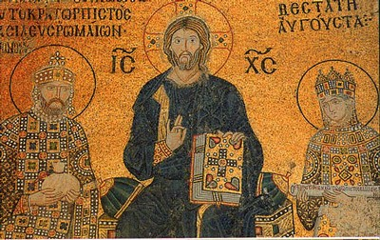
Byzantine Culture
State-organized education system: reading, writing, grammar
Boys and girls educated; literacy was quite high
Creativity in architecture (domed buildings; new heights)
Richly colored religious mosaics in a distinct Byzantine style
Flat, frontal, formal, gold backgrounds
Icon paintings (paintings of saints and religious figures)
8th c: Iconoclastic Controversy
Cultural life blended Hellenism and Orthodox Christianity

Slide 14
Great Schism (1054)
Separate paths emerged as a result of disagreements well before this official “split”
1054: Mutual excommunication (Patriarch Michael vs Pope Leo IX)
Church splits into two traditions: Greek/Eastern Orthodox and Roman Catholicism
 | Roman Catholicism (West) | Greek Orthodox (East)
Political & Religious Power | Religion (pope) > State (kings) | Caesaropapism: State (emperor) > Religion (patriarch)
Clerical Celibacy | Yes | No
Eucharist | Unleavened | Leavened
Bible | Latin (inaccessible) | Greek (accessible)
Influences | Roman law | Greek philosophy

Slide 15
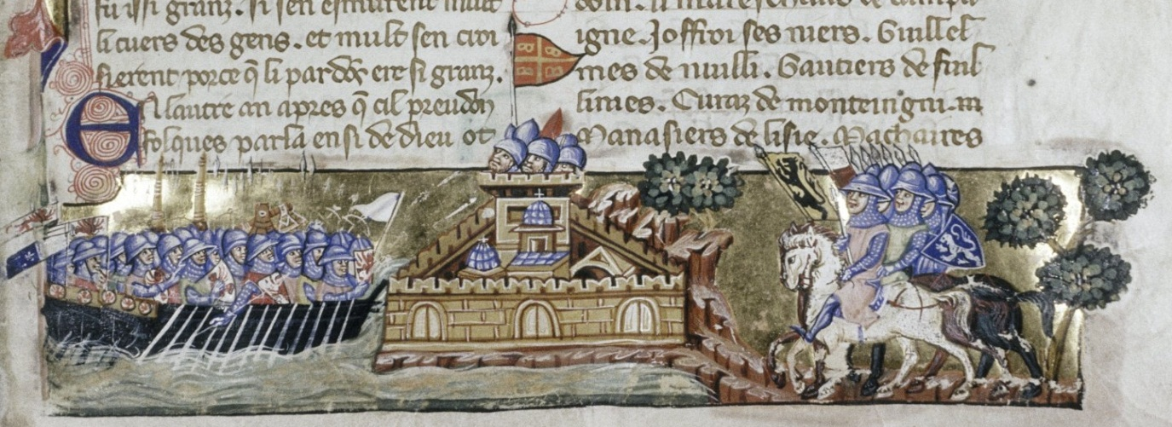
Byzantine Decline (ends in 1453)
Decline begins after 1054 (Church schism); West are official enemies
1) 1071: Battle of Manzikert (Seljuk Turks take most of Central Asian provinces; removes important sources of taxes, food, trade)
2) Independent Slavic states (Bulgaria, Serbia) break away from Byzantine control and diminish Byzantine power
3) 1204: 4th Crusades (Crusaders and Venetian merchants sack Constantinople)
1453: Constantinople taken by Ottoman Turks; empire collapses

Slide 16
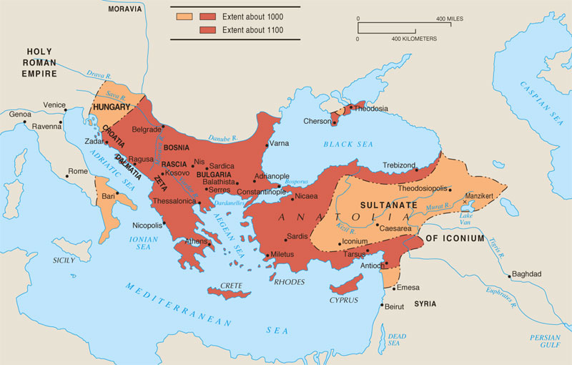
The Byzantine Empire (1000-1100)
Byzantine Empire went from a “major” to “minor” power after the Byzantine loss at the Battle of Manzikert in 1071 against the Seljuk Turks.

Slide 17
Quick Review Question
Describe the Great Schism. What are the main points of contention?
What contributes to the downfall of the Byzantine Empire?

Slide 18
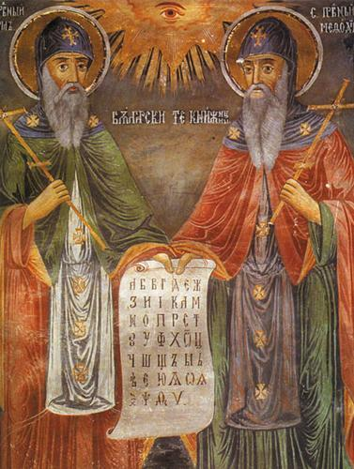
Eastern Europe
Eastern Europe was influenced by Byzantine conquest, Greek Orthodox missionaries and conversion efforts, and trade routes
9th c.: Byzantine Christian missionaries (Cyril and Methodius) helped bring Orthodoxy northward into Russia and Eastern Europe
Created new alphabet: Cyrillic script
Created literacy base in eastern Europe

Slide 19
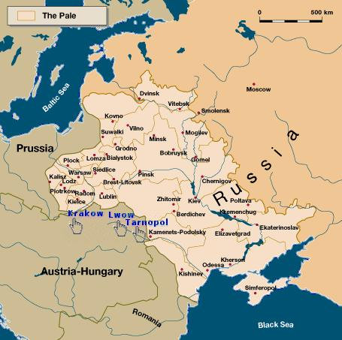
Jews and Christians in Eastern Europe
Competition between Catholics and Orthodox Greeks for converts
Catholic converts: mostly in Hungary, Poland
Mostly, communities convert to Orthodoxy
Influx of Jews to Western Russia/Eastern Europe to escape persecution
Later, called the Pale of Settlement
Migrate into region in large numbers (Poland)
High value placed upon education and literacy for males
Limited professions available; gain strength in local commerce; barred from agriculture
Resented by Christian community

Slide 20
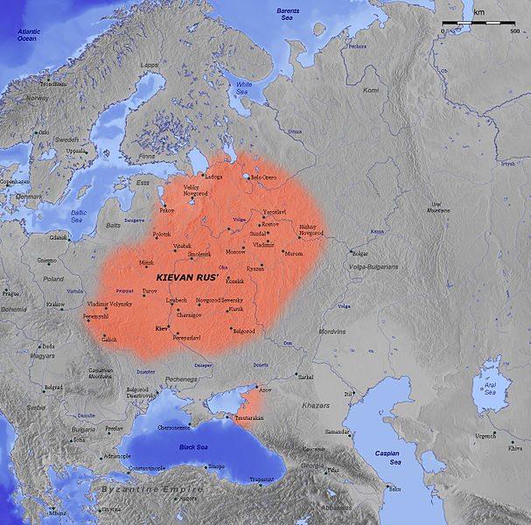
The Emergence of Kievan Rus’
Who are the Russians?
Groups from Asia moved into region during Roman Empire
Agricultural society, ironwork,
Family tribes, villages
Conduit for trade between Byzantines and Scandinavia
Luxury products from Silk Roads traded for furs from Scandinavia
855: large trading city (Kiev) became kingdom under Danish merchant Rurik, first Prince of Kievan Rus’
Alliances with Byzantine rulers

Slide 21
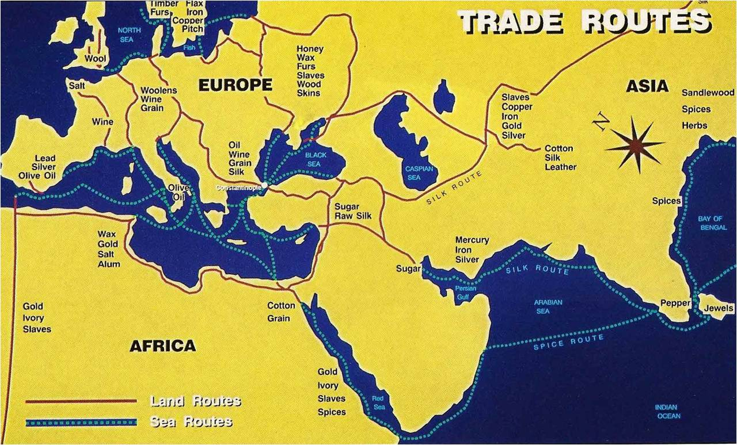

Slide 22
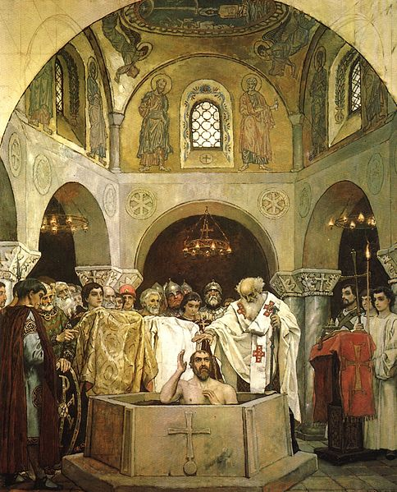
Politics and Religion in Kievan Rus’
Vladimir I (980-1015)
What religion to choose?
1000: Converts to Orthodoxy on behalf of all his people; organizes mass baptisms and forced conversions with military pressure.
Develops Russian Orthodox Church
Controls church and creates literate Russian priesthood
Byzantine influence flows into Russia
Yaroslav (1019-1054)
Develops and issues formal law code
Arranged marriages with central European royalty
Translates religious literature from Greek to Slavic
Conversion of Vladimir I

Slide 23
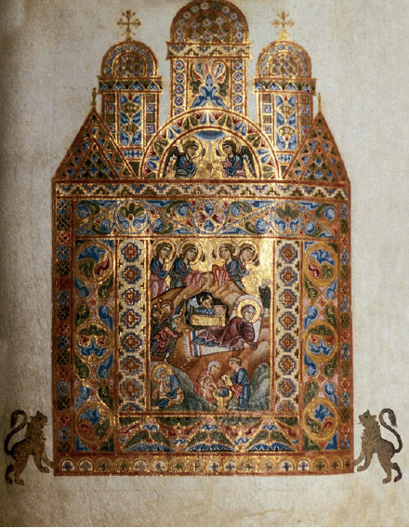
Culture/Society in Kievan Rus’
Byzantium → Kievan Rus’ → Russian culture
Attracted to ceremony and luxury of Byzantium
Peaceful trade relationship between Byzantium and Kievan Rus’ facilitates cultural exchange
Greek Orthodox influence on Russian Orthodox Church
Ornate churches; domes; massive size
Monasticism develops, stress prayer and charity
Fervent religious devotion; no interest in science, math (different than Islam)
Art (icons, illuminated manuscripts), literature (using Cyrillic, focused on religious events)
Peasants were free farmers, and aristocratic landlords (boyars) had less political power than similar Westerners

Slide 24
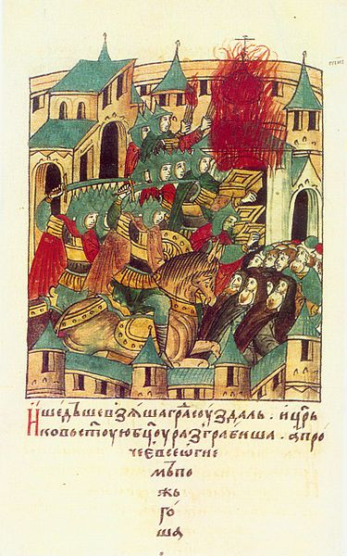
Kievan Decline
Decline from 12th century
Other regional leaders and princes became rivals
Succession struggles within royal family
Central Asian invaders weaken borders
1223: Mongols invade (Battle of the Kalka River)
Aided by rival princes, Mongols take major cities easily
Will control much of Russia for over two centuries
1453: Fall of Byzantium reduces Russian trade and wealth
Orthodox Christianity and Russian culture remain, despite political chaos → provide continuity for community

Slide 25
Quick Review Question
How does Kievan Rus’ emerge?
Describe its culture.
What contributes to Kievan decline?

